Slide 1
What’s New in SQL Server 2019?
Baton Rouge User Groups Nov 2019

Slide 2


The Business Case for SQL Server 2019

Slide 3
Audience
This version of the presentation is for IT decision makers, management, C-level
This is part of a larger presentation on all the new things in SQL 2019, including:
New syntax
New maintenance feature
New machine learning features, and more

Slide 4
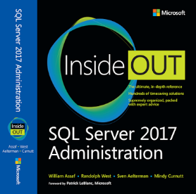
Favorite New Features
http://www.sqltact.com/2017/12/our-sql-server-2017-administration.html 4. What's your favorite new feature of SQL Server 2017? William Assaf: WSFC-less Availability Groups. So many uses, so much easier. With automatic seeding, AG's are close to point-and-click. Randolph West: Linux support. Adaptive query processing. Linux support. Sven Aelterman: Without a doubt, the fact that Reporting Services is a separate download. Everyone loves an additional installer. Mindy Curnutt: Resumable online index rebuilds!! How many times could I have used this. I wonder if Ola's updated his scripts yet to take this into consideration? Louis Davidson: I am into database coding/designing mostly, so graph tables are highest for sure. They are pretty rudimentary now, but the future is very bright in what they are adding in a future version.

Slide 5
IT Leadership: Need to Know Changes
PolyBase

Slide 6
SQL Server Version Velocity
SQL 2005 RTM- Nov 7 2005
SQL 2008 RTM- Aug 7 2008 – 33 months later
SQL 2008R2 RTM- April 21 2010 – 20 months later
SQL 2012 RTM- March 6 2012 – 23 months later
SQL 2014 RTM- April 1 2014 – 25 months later
SQL 2016 RTM- June 1 2016 – 26 months later
SQL 2017 RTM- Oct 2 2017 – 16 months later
SQL 2019 RTM- Nov 4 2019 – 25 months later

Slide 7
SQL Server Version Velocity
Starting with SQL 2017, no more service packs, CU’s only.
Stated goal of one CU per month at least for one year.
Within 12 months, 12 CU’s for SQL 2017
17 CU’s in first 24 months
First public preview of SQL 2019 was only 11 months after SQL 2017 RTM

Slide 8
SQL Server is ready to Upgrade
Thanks for compatibility levels inside each database, the only valid reasons to delay a SQL Server upgrade these days are vendor support
Changes are additive – never code breaking
Changes to execution plans in SQL 2014 were 90/10
Easier to upgrade past SQL 2014 from <2014 because of the Query Store introduced in SQL 2016

Slide 9
Summary of Changes in SQL 2017

Slide 10

SQL on Linux
Red Hat Enterprise (RHEL) preferred, also Ubuntu, SUSE Linux Enterprise
Almost fully-featured SQL on Linux
Support for integrated Active Directory auth
Linux cluster managers like Pacemaker can be used

Slide 11
SQL on Linux
SQL Server “mssql-server” installs on Linux, but SSMS won’t.
Options for tooling on Linux:
Install SSMS on Windows, manage SQL on Linux remotely
“mssql-tools” installs command-line tools Sqlcmd, bcp, drivers and more on Linux
SQL Server Operations Studio – new cross-platform SQL management software that is, based Visual Studio Code
Third party software

Slide 12

SQL in Docker
SQL Server 2017 container images now supported in Docker
There are images for both Windows and Linux, supported for Docker on Mac and Windows
Quick start walkthrough:
https://docs.microsoft.com/en-us/sql/linux/quickstart-install-connect-docker

Slide 13
Availability Groups Possibilities
Enterprise Edition Availability Groups – (typical, since SQL 2012)
Synchronous/Async, Automatic Failover possible
Cross-OS possible using WSFC on Windows or Pacemaker on Linux
Basic Availability Groups – (Introduced in SQL 2016 Standard ed)
Replaces DB Mirroring: 2 nodes, secondary replica can’t be used
Distributed Availability Groups – (Introduced in SQL 2016)
AG treats another AG as a replica (over WAN), up to 17(!) replicas
Clusterless (!!!) Availability Groups – (Introduced in SQL 2017) …

Slide 14
Clusterless Availability Groups
New in SQL 2017. Does not require a WSFC! No quorum! Hooray!
Cross-OS: Win+Win, Win+Linux, Linux+Linux
No automatic failover possible, manual failover possible
Full-featured, including readable sync/async replicas
Create SQL-based listener without a cluster, so Read-Only Routing still possible
Referred to as “Read-scale availability groups” in docs

Slide 15
New Availability Groups Features
Required Synchronized Secondary Replicas to Commit option:
If you have multiple synchronous Secondary nodes, you can configure the AG to require the Primary node to synchronize with fewer than all of them. This is a transactional safety option, not for performance!
0 – Behavior we’re used to. A synchronous secondary replica that stops responding does not stop the Primary from committing. If all synchronous replicas drop, Primary is OK (though T-Log grows.)
1+ - At least as many secondary replicas as the value of the setting must be SYNCHRONIZED, or transactions on the primary replica will not be allowed to commit!

Slide 16
Availability Groups Features
Automatic Seeding (first introduced in SQL 2016) has more improvements, including speed and stability:
Now file paths on each replica don’t need to match (but they should!)
Automatic seeding is fast, easy way to stream data from primary to secondary replicas, without a backup/restore or a network share.
It performs a backup using the Mirroring endpoint as a virtual backup device, and can compress the data transfer to reduce network usage.

Slide 17
Availability Groups Features
Distributed transaction support:
SQL 2016 introduced support for distributed transactions using DTC for databases on different instances.
SQL 2017 allows for cross-database transactions using DTC for databases on the same or different instances.
SQL 2017 now uses DTC even when databases in an availability group in the same instance of SQL Server
New syntax needed to support setup of the Availability Group: DTC_SUPPORT = PER_DB

Slide 18
Availability Groups Features
Just a reminder, since SQL 2016:
The SSIS database (SSISDB) can be part of an Availability Group for DR and HA
The SSRS databases can be part of an Availability Group but do not support automatic failover to the listener, even with MultiSubnetFailover specified, so manual failover is required.

Slide 19
Thanks, Azure SQL DB!
Some features that were developed cloud first for Azure SQL Database (PaaS) now available to SQL Server:
Query Store
Automatic Plan Correction

Slide 20
Query Store
New in SQL 2016, even better in SQL 2017.
Starting with SQL 2017, tracks Wait Stats too
Tracks the performance of queries – not of execution plans – a distinct difference.
Can detect when a query has suffered a degradation in performance because its query plan has changed.

Slide 21
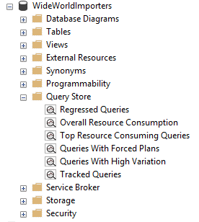
Query Store
Built-in reports make analysis easy
For SQL Server databases, this isn’t enabled by default. Go enable it in each database SQL 2016+.
Minimal overhead – collected data is stored asynchronously, flushed to disk periodically

Slide 22
Query Store
Easily identify the worst-performing queries
“worst plans in cache” is a common strategy to identify the most expensive plans and start there
The Query Store is one step better – finding the recent “worst queries” regardless of plan, with sortable/aggregable metrics to start tuning

Slide 23
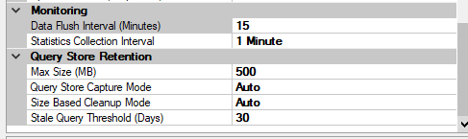

Query Store
Data Flush Interval
In-memory Data that could be lost in the event of a system crash or sudden power loss. Default 15 minutes
Statistics Collection Interval
Grain of the data collection. Default of 1 hour.
Defines the automatically generated time windows and stores aggregated statistics on that interval
Max Size (MB)
Actual space on disk inside the user database. Default 100 MB probably isn’t enough to track busy history.

Slide 24
Query Store
By default Query Store automatically cleans up, removing the least expensive and oldest queries first as the query data size approaches the Max Size (MB) value.
You can also manually clear the Query Store data (for testing only) with the command:
ALTER DATABASE [WideWorldImporters] SET QUERY_STORE CLEAR

Slide 25
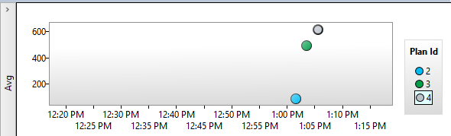
Query Store
Bad!
Regressed Queries highlights query execution over time
There are a lot of reasons queries could regress:
Dropping indexes (results in a new plan) is one of the easiest to manually reproduce
Plans could be flushed from cache, regenerated differently
Other reasons: parameter sniffing, changing or outdated statistics, changing compatibility levels especially +-12.0 (2014).

Slide 26
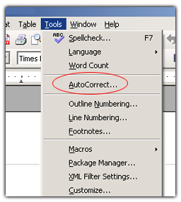
Query Store – Next Logical Step?
What if SQL Server could use information about Regressed Queries and a history of execution plans to decisions to automatically use a better execution plan?
Now it can! Automatic Plan Correction (new to SQL 2017)!
Again, Azure SQL Database already does this for you!

Slide 27

Automatic Plan Correction
Available in Azure SQL and now in SQL 2017 to revert a query from a newer, slower plan to an older, faster plan.
No DBA intervention needed.

Slide 28
Automatic Plan Correction
DBA’s can also accomplish this manually
Query a host of DMV’s including sys.dm_db_tuning_recommendations
Sample query: https://docs.microsoft.com/en-us/sql/relational-databases/automatic-tuning/automatic-tuning

Slide 29
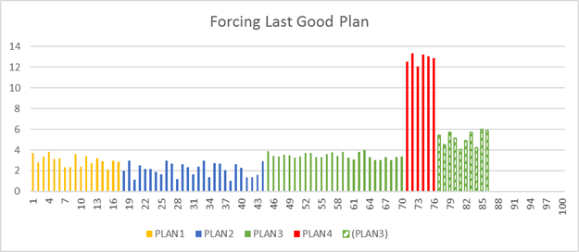
Automatic Plan Correction
https://docs.microsoft.com/en-us/sql/relational-databases/automatic-tuning/automatic-tuning#automatic-plan-correction

Slide 30
Automatic Plan Correction
Not on by default, you must enable
Once you turn-on this option, Database Engine will automatically force any recommendation where the estimated CPU gain is higher than 10 seconds.
ALTER DATABASE WideWorldImporters
SET AUTOMATIC_TUNING ( FORCE_LAST_GOOD_PLAN = ON );

Slide 31
RESUMABLE Index Maintenance
Introduced in SQL Server 2017, this makes it possible to pause an index operation and resume it later, even after a server shutdown.
Got an index that takes so long to update, you don’t have a maintenance window long enough?
You can make partial progress towards index maintenance each night until the work is done.

Slide 32
RESUMABLE Index Maintenance
PAUSE an index maintenance operation instead of killing it, which causes a potentially lengthy rollback.
This rollback can be disruptive, even for an ONLINE=ON index rebuild operation.
You can even use the MAX_DURATION syntax to automatically pause after a specified amount of time.

Slide 33
On the Topic of Index Maintenance
Used to having to write your own index maintenance scripts because of ham-handed Maintenance Plans?
Check again! Maintenance Plans since SQL 2016 have dramatically increased in capability to perform complex, conditional index maintenance operations.
You can configure the REORGANIZE and REBUILD tasks to maintain only indexes filtered by percentage of fragmentation level or page count.

Slide 34
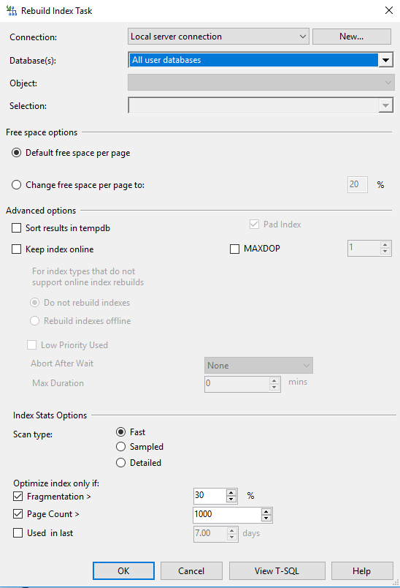
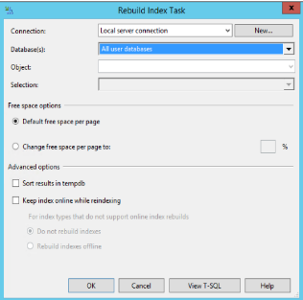
SQL 2014 (left) vs SQL 2017 (right)
Rebuild Index Task

Slide 35
On the Topic of Maintenance
Quick aside on Integrity Checks
Starting with SQL 2016, you can specify
DBCC CHECKDB (MAXDOP =1)
Increasing duration, but potentially reducing CPU overhead and flexibility for maintenance.

Slide 36
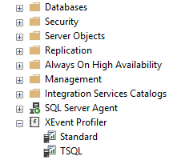
New Feature in SSMS (17.3+)
New easy-to-use Extended Events sessions Works all the way down to SQL 2008 R2
Pre-made XEvent sessions geared to appear familiar to the TSQL traces provided by Profiler
Ditch Profiler and Trace: XEvents are better!
Superior filtering, sorting, all inside SSMS
Superior performance – asynchronous means little overhead
Capture to a variety of outputs including an in-memory Ring Buffer or a Histogram to count incidents of events

Slide 37
SQL Server Tooling
SSMS pulled out of .iso in SQL 2016, web download now
New releases every two months throughout 2017
SSDT still tied to Visual Studio release cycle. SSDT for VS2017 released April 2017.
SQL Server Operations Studio (SSOS) is in preview
runs on Windows, macOS, and Linux
Free, lightweight, based on Visual Studio Code
Not on par with SSMS (yet?)

Slide 38
Data Analytics and Artificial Intelligence
All in the same installer as SQL Server, included in the license
Two main features/installables:
PolyBase Query Service
+
Machine Learning Services

Slide 39
PolyBase Query Service For External Data
The PolyBase Query Engine makes it possible to query Hadoop nonrelational data or Azure Blob Storage files using T-SQL
Supports various legacy versions of the Hortonworks Data Platform with a configurable Hadoop Connectivity option.

Slide 40
Machine Learning Services
2016- “R Services” supported R
2017- “Machine Learning Services” supports R and Python
You can install R and Python independently or together, depending on your requirements.
What’s more, you can install these ML services directly in the Database Engine (in-database as a service called LaunchPad)
or as standalone components without a SQL Server.

Slide 41
Machine Learning Services
Data scientists can take advantage of this feature to build advanced analytics, data forecasting, and algorithms
for machine learning.
SQL Server 2017 installs version 9 of the Microsoft R Open Server, supported for both Windows and Linux, and yes,
it requires installing the Oracle JRE 7+ on your Windows server. (ew!)

Slide 42
Graph Tables
New to SQL 2017
Graph data is often associated with networks, such as social networks. Graphs data structures consist of nodes and edges.
Nodes are also referred to as vertices, and edges as relationships.
Interconnected, many-to-many relationships
Hierarchical data can be served with a special hierarchyid data type
Solution is limited currently, and not as fully featured compared to dedicated graph table solutions.

Slide 43
State of the Columnstore
Columnstore indexes aren’t new, have been around since SQL 2012.
Not a B-tree; highly compressed column data (disk and memory).
You can create “nonclustered” or “clustered” Columnstore indexes, though these are in name only. Again, underlying structure is different, but Columnstore indexes can serve the roles of either.
Can only have one Columnstore index per table, and can mix rowstore nonclustered indexes with Columnstore indexes of any type.

Slide 44
State of the Columnstore
Writeable as of SQL 2016. Prior, a CS index was read-only.
This finally unleashed the indexes for use in OLTP.
Starting with SQL 2016, you can add a Columnstore index to in-memory tables for “real-time analytics”.
With SQL Server 2016 SP1, Columnstore indexes are available below Enterprise edition with memory limits.
Starting with SQL 2016, you can now filter the Columnstore index just like a nonclustered index.

Slide 45
State of the Columnstore
Starting with SQL 2017, Columnstore indexes are the only objects for which SQL can use Batch Mode execution.
Available in Compatibility Level 14.0 (SQL 2017) only.
You’ll see “Batch” (instead of the default “Row”) in the Actual Execution Mode of an execution plan operator
Batch mode memory grants and adaptive joins are part of new Adaptive Query Processing in SQL 2017. https://docs.microsoft.com/en-us/sql/relational-databases/performance/adaptive-query-processing

Slide 46
SQL Server Features
Let’s talk about new stuff in
SSIS
SSRS
SSAS

Slide 47
SSIS
Yep, runs on SQL on Linux.
New Azure Feature Pack for SSIS released August 2017
Downloads for each SQL version since 2012
Includes Control and Data Flow components including for Azure Storage blobs, Resource Manager, HDInsight, and Data Lake
New Master/Worker SSIS scale-out.
Details: https://docs.microsoft.com/en-us/sql/integration-services/azure-feature-pack-for-integration-services-ssis

Slide 48
SSIS ScaleOut
New Master/Worker SSIS scale-out
Execute packages in parallel on multiple instances
One SSIS “Master” instance to rule them all
Masters/Workers communicate via certificate-encrypted endpoints
Each instance runs the same package
More details: https://docs.microsoft.com/en-us/sql/integration-services/scale-out/integration-services-ssis-scale-out

Slide 49
Azure SSIS Lift-and-Shift (coming soon!)
In public preview Q4’17, should be released soon
Seamlessly upload your on-prem SSIS packages to an Azure SSIS service
Packages upgraded to SQL 2017 upon upload
Complete, cloud-based enterprise ETL

Slide 50
Azure SSIS Lift-and-Shift (coming soon!)
With few code changes, run SSIS packages in Azure Integrated Runtime (IR) instead of a SQL instance.
More info: https://docs.microsoft.com/en-us/azure/data-factory/tutorial-deploy-ssis-packages-azure
Side note: Data Factory v1 was just really terrible, replaced by v2 (in public preview now)

Slide 51
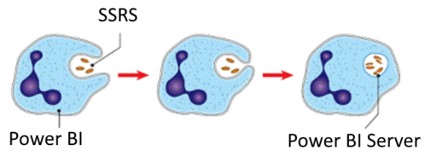
Power BI + SSRS = Power BI Report Server
SSRS pulled out of .iso in SQL 2017
Free web download, but license is not free.
Still need a product key from production SQL license.
Power BI Report Server
Not free, comes with Power BI Premium or SA
Alternative to an SSRS install. Contains SSRS + more.

Slide 52
SSRS
New in 2017: integrated commenting system now built-in to the SSRS Report web portal
SharePoint Integrated mode is no more, as is most development for on-prem SharePoint
More details: https://docs.microsoft.com/en-us/sql/reporting-services/what-s-new-in-sql-server-reporting-services-ssrs

Slide 53
SSRS
Now in SQL 2017, SSRS has a modern REST API available for custom access to the report server catalog.
Replaces the old SOAP API
Shared Datasets in SSRS can be access by Power BI reports via this modern API

Slide 54
Lots of SSRS Change in SQL 2016
SSRS got a complete revamp in SQL 2016
Paginated reports still there, but mobile reports now possible for mobile/tablet screen formats
Completely new Report Manager and Web Portal
Integration with Power BI account
Users have seamless access to on-prem SSRS reports and cloud-based Power BI dashboards in the same web portal

Slide 55
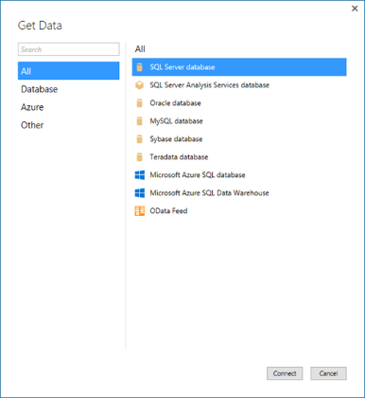
SSAS Changes in 2017
Long-needed setup change:
Tabular mode now default not Multidimensional
Nicer, modern experience in SSDT brought over from Power BI, other SSDT QOL improvements
Better support for parent-child hierarchies in Tabular
More Details: https://docs.microsoft.com/en-us/sql/analysis-services/what-s-new-in-sql-server-analysis-services-2017

Slide 56
SSAS Changes in 2017
New DAX function: “IN” mimics TSQL “IN”
From: Rusty Frioux Sent: Thursday, February 15, 2018 12:45 PM To: William Assaf <william.assaf@sparkhound.com> Subject: RE: good luck tonight
DAX IN! DAX IN! DAX IN! OMG THEY ADDED *IN* TO DAX. NO MORE 300 LINE NESTED IF THEN STATEMENTS IN THAT STUPID EXCEL SYNTAX.
DAX IN!

Slide 57
New SQL Server 2017 Syntax
EXTERNAL DATA SOURCE
ENABLE_PARALLEL_PLAN_PREFERENCE
CONCAT_WS (concatenation with separator)
TRIM (instead of LTRIM, RTRIM)
TRANSLATE (massive character replace)
STRING_AGG (easily concatenate rows to a delimited list string)

Slide 58
Bulk Access to Azure Blob Storage
New to SQL 2017, perform bulk insert operations directly off of Azure Blob storage files
Secured using Shared Access Signature Credentials
No need for HADOOP – write straight to SQL
Details: https://docs.microsoft.com/en-us/sql/relational-databases/import-export/examples-of-bulk-access-to-data-in-azure-blob-storage

Slide 59
Bulk Access to Azure Blob Storage
Example: bulk insert from a .csv in Azure blob storage using EXTERNAL DATA SOURCE
You can also use EXTERNAL DATA SOURCE for Azure SQL Database-to-Azure SQL Database connectivity, because you can’t use Linked Servers.

Slide 60
Force Parallel
Advanced troubleshooting/optimization option new to SQL Server 2017 (and also in SQL Server 2016 CU2)
Force a query to use a parallelized execution plan:
OPTION(USE HINT('ENABLE_PARALLEL_PLAN_PREFERENCE'));

Slide 61
CONCAT_WS
Concatenate with separator
Example: Place a comma between any number of values
SELECT CONCAT_WS(',’, name, current_utc_offset, is_currently_dst)
FROM sys.time_zone_info
Dateline Standard Time,-12:00,0
--Wrap in " for text qualification on csv import
SELECT CONCAT_WS('","', '"'+name, current_utc_offset, is_currently_dst)+'"'
FROM sys.time_zone_info
"Dateline Standard Time","-12:00","0"

Slide 62
STRING_AGG
Quickly create .csv strings with row data!
An Aggregate Operator (like SUM, AVG)
that concatenates with a separator between values (again, not at the end!)
SELECT STRING_AGG(name, ', ') FROM sys.time_zone_info
WHERE NAME LIKE '%central%';
Central America Standard Time, Central Standard Time, Central Standard Time (Mexico), Canada Central Standard Time, Central Brazilian Standard Time, Central Europe Standard Time, Central European Standard Time, W. Central Africa Standard Time, Central Asia Standard Time, N. Central Asia Standard Time, Aus Central W. Standard Time, AUS Central Standard Time, Central Pacific Standard Time
Central America Standard Time, Central Standard Time, Central Standard Time (Mexico), Canada Central Standard Time, Central Brazilian Standard Time, Central Europe Standard Time, Central European Standard Time, W. Central Africa Standard Time, Central Asia Standard Time, N. Central Asia Standard Time, Aus Central W. Standard Time, AUS Central Standard Time, Central Pacific Standard Time

Slide 63
TRANSLATE
Easier way to do 1-for-1 character replacement
Far less syntax than nested REPLACE statements
Slightly less flexible than REPLACE
Allows for a 1-to-1 character replacement only.
Can’t replace or ‘ ‘ with ‘’
Can replace ‘abcdef’ with ‘123456’ with significantly less code

Slide 64
TRANSLATE
Same result:
SELECT TRANSLATE('abcdef', 'abcdef', '123456’)
Vs
SELECT
REPLACE(REPLACE(REPLACE(REPLACE(REPLACE(REPLACE( 'abcdef','a', '1'),'b', '2'),'c', '3'),'d', '4’) ,'e', '5'),'f', '6')

Slide 65
TRIM
No more LTRIM(RTRIM(some_varchar))!
Now in SQL 2017 you can just TRIM(some_varchar)!

Slide 66



HEALTH CHECK
REMEDIATION
MANAGED SQL
The Sparkhound SQL DBA Team
Knowledge Transfer – We work with your Devs, DBA’s, “accidental” DBA’s.
Pros Nearby – Sparkhound’s DBA team of FTE’s are US-based, CT zone.
Microsoft & Peer Recognized – Sparkhound DBA team is 100% Microsoft certified, and members have spoken at conferences and user groups.
Proven Success – For years we have supported servers in US and Europe.
Dev Background – Experience as former developers provides context.
The Checklist - Reference for future checks, audit prep, new SQL builds.

Slide 67
Sparkhound Managed SQL
HEALTH CHECK
REMEDIATION
MANAGED SQL
Interactive Health Check
Windows, SQL, Process
Remediation
Planning
Proactive Health Checks
Reactive Alerting
Regular Maintenance Windows
Knowledge Transfer
Special Project Assistance
Documentation/Process Improvement
Trending/Analysis
Checklist
Critical
High
Medium
Low
Checklist
Maintenance
Window
Managed Services
Emphasis on Knowledge Transfer
What, Why, How

Slide 68
Sparkhound SQL DBA Consulting Services
Performance Tuning, with App Services team
Reporting, with our Data Analytics team
Upgrades/Migrations/Data Conversions
High Availability/Disaster Recovery solutions
Pre-audit, encryption, database security
Maintenance/administration
Automation/PowerShell
Azure SQL (IaaS or PaaS) architecture
Training/Knowledge Transfer/skillset updates

Slide 69
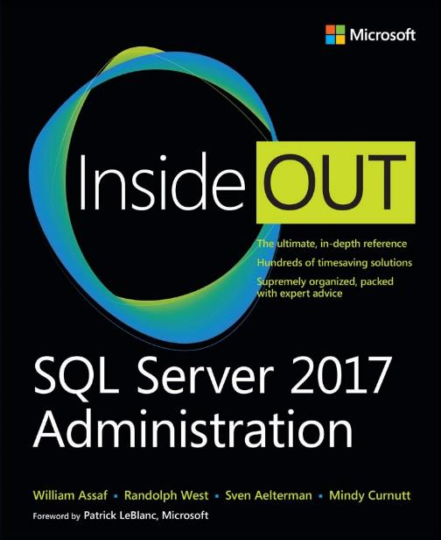
Save 40% on book or eBook
with discount code SQL
www.microsoftpressstore.com
Free U.S. shipping
eBooks include EPUB, PDF, & MOBI
Offer expires May 31, 2018

Slide 70
Need More Technical Detail?
Presenting at:
Baton Rouge SQL Server User Group – March 14
Houston Tech Fest – May 5
SQLSaturday Dallas – May 19
SQLSaturday Pensacola – June 2
SQLSaturday Houston – June 23
SQLSaturday Baton Rouge – August 11

Slide 71





Free SQL Server, .NET, Business Intelligence training and more!
An all day FREE training event with SQL Server and Development related sessions spread out over multiple tracks of Business Intelligence, SQL Development,
Database Administration, IT Pro, .NET,
Career Development, and CIO/IT Management
See you August 11 at
SQLSatBR.com

Slide 72

Bio and contact
William D Assaf, MCSE
Baton Rouge SQL Server UG board and SQLSaturday chair
Principal Consultant, Manager – DBA Team at Sparkhound Baton Rouge
William.Assaf@sparkhound.com

Slide 73
Bio and contact
William D Assaf, MCSE
Baton Rouge SQL Server UG board and SQLSaturday chair
Principal Consultant, Manager – DBA Team at
Sparkhound Baton Rouge
William.Assaf@sparkhound.com
Twitter: @william_a_dba
This presentation, including all source code and this slide deck, has been posted at my blog:
SQLTact.com

